Slide 1

Arm Addressing Modes
Chapter 6
Sepehr Naimi
www.NicerLand.com

Slide 2
Topics
Alignment
Little endian vs. Big endian
Advanced Indexed Addressing Modes
Bit-addressable memory
LDR pseudo-instruction & PC relative addressing

Slide 3
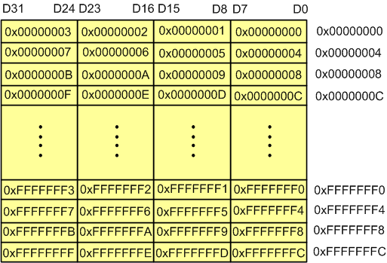

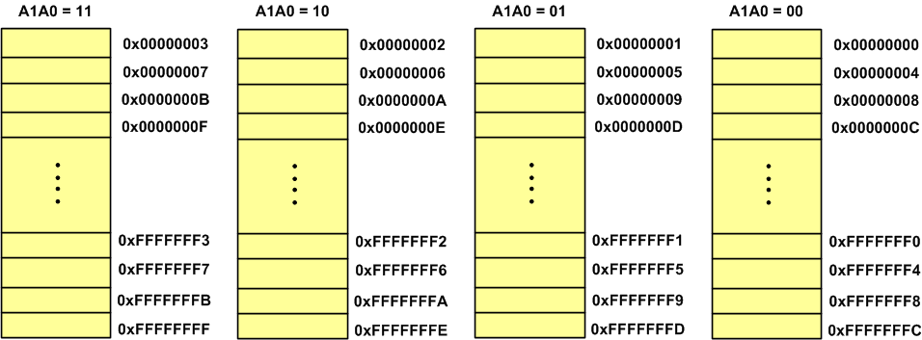

Slide 4
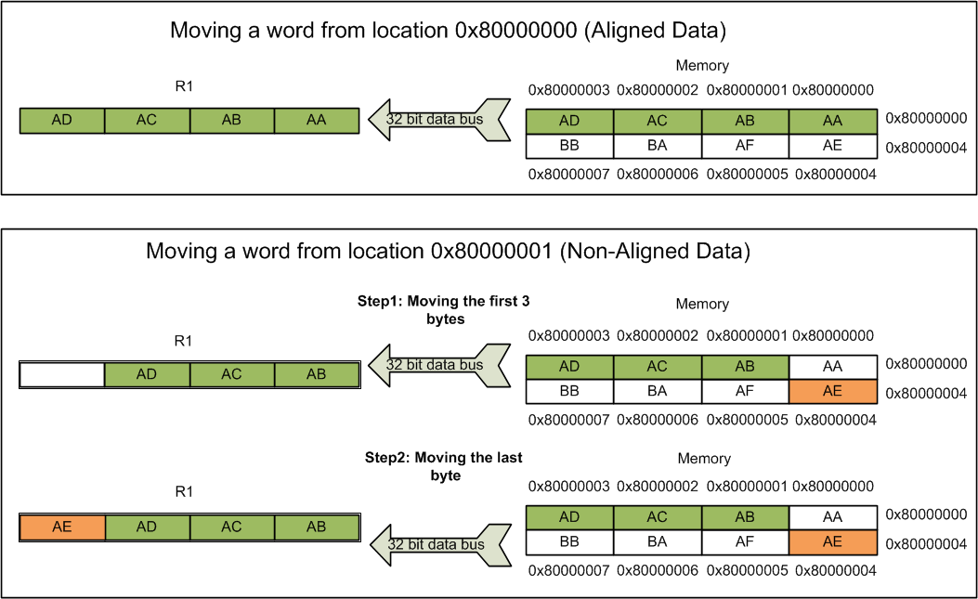
Alignment and misalignment

Slide 5
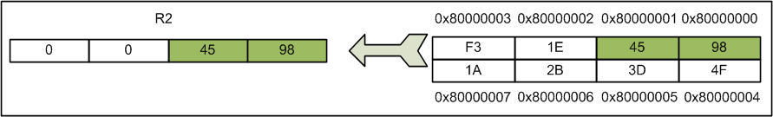
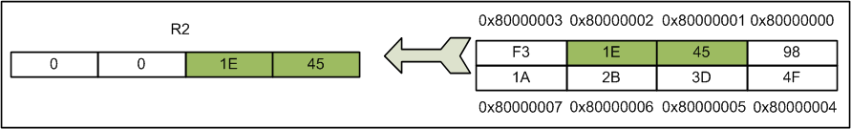
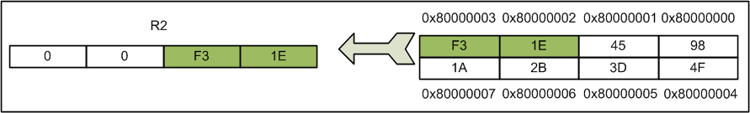
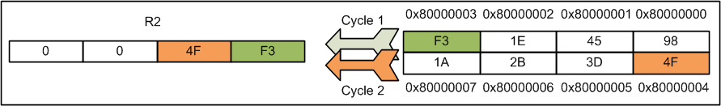
16-bit data and memory alignment

Slide 6
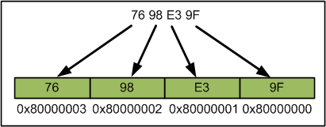
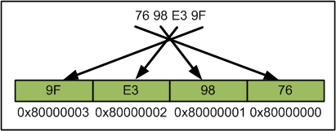
Little endian vs. Big endian
LDR R2, =0x7698E39F @ R2=0x7698E39F
LDR R1, =0x80000000
STR R2, [R1]
Little endian
Big endian

Slide 7
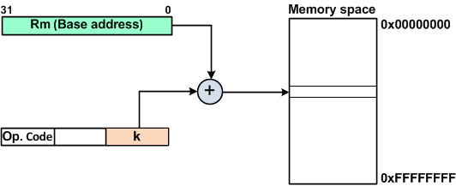
Pre-indexed Addressing Mode with Fixed Offset
STR Rd, [Rm, #k]
LDR Rd, [Rm, #k]
LDR R5, [R2, #4] @ R5 = contents of location R2+4

Slide 8
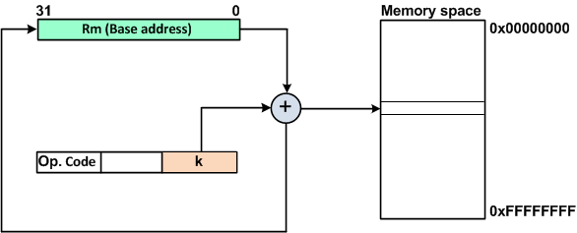
Pre-indexed Addressing mode with write-back and fixed offset
LDR Rd, [Rm, k]!
STR Rd, [Rm, k]!

Slide 9
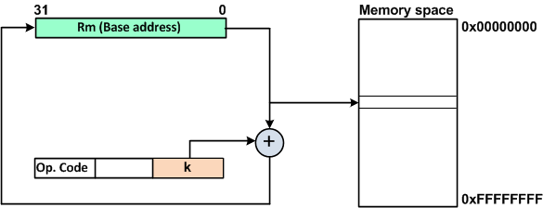
Post-indexed Addressing mode
LDR Rd, [Rm], #k
STR Rd, [Rm], #k

Slide 10
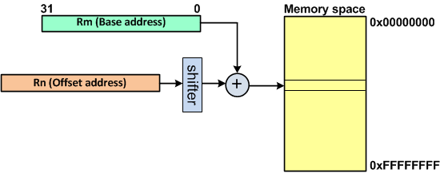
Pre-indexed Address mode with Offset register
LDR Rd, [Rm, Rn]
STR Rs, [Rm, Rn]
LDR Rd, [Rm, Rn,shift]
STR Rs, [Rm, Rn,shift]
LDR R5, [R2, R1] @R5=contents of loc. R2+R1
LDR R6, [R2, R1, LSL #2] @ R6= [R2+(R1<<2)]

Slide 11
Post-indexed scaled register
STR R1, [R2], R3, LSL #2
@ store R1 at location R2 of memory
@ and write back R2 + (R3 × 4) to R2.
LDR R1, [R2], R3, LSL #2
@ load location R2 of memory to R1
@ and write back R2 + (R3 × 4) to R2

Slide 12
Look-up table
Assuming R2 has the x value range of 0–6, the program calculates 10 to the power of R2 and stores the result in R3.
.text
.global _start
_start:
ldr r1, =lookUp @ point to LOOKUP
ldr r3, [r1, r2, lsl #2] @ r3 = entry of lookup table index by R2
mov r7, #1
svc 0
lookUp: .word 1, 10, 100, 1000, 10000, 100000, 1000000

Slide 13
Bit-addressable Memory

Slide 14
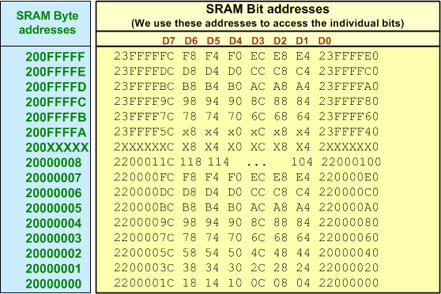
SRAM bit-addressable Memory
Bit alias address = Bit alias base address + Byte offset × 32 + Bit number × 4

Slide 15
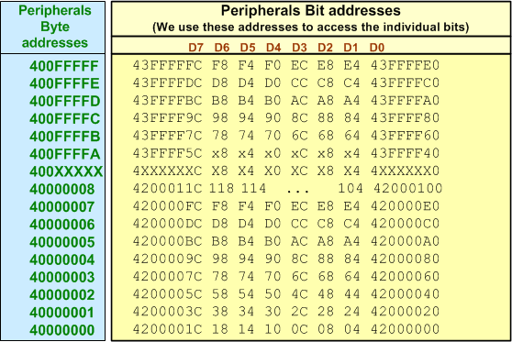
Peripheral bit-addressable region

Slide 16
LDR and ADR Pseudo-instructions and PC Relative addressing

Slide 17
ADR Pseudo-instruction
ADR Rn, Label
  ADD Rn, PC, #offset

Slide 18
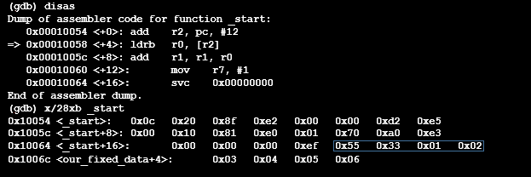
ADR Pseudo-instruction Example
.text
.global _start
_start:
adr r2, our_fixed_data @ r2 points to our_fixed_data
ldrb r0, [r2] @ load r0 with the contents of memory pointed to by r2
add r1, r1, r0 @ add r0 to r1
mov r7, #1
svc 0
our_fixed_data:
.byte 0x55, 0x33, 1, 2, 3, 4, 5, 6

Slide 19
PC Relative addressing
LDR Rd, [PC, #k]

Slide 20
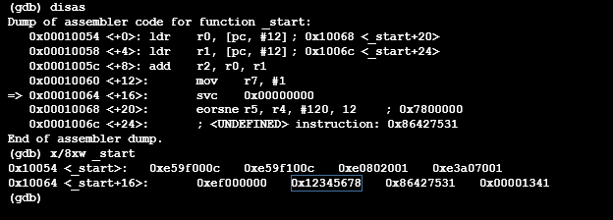
LDR Pseudo-instruction
.text
.global _start
_start:
ldr r0, =0x12345678
ldr r1, =0x86427531
add r2, r0, r1
mov r7, #1
svc 0

Slide 21
Stack

Slide 22
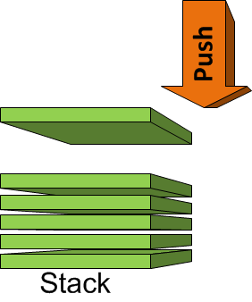
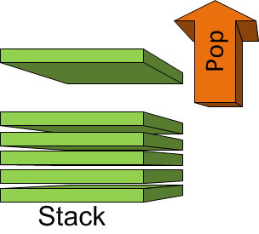
Push and Pop
Push
Pop

Slide 23
Stack Pointer
R13 is the stack pointer
PUSH {Rn}
  SP = SP – 4
  [SP] = Rn
POP {Rn}
  Rn = [SP]
  SP = SP + 4
0x2000050
0x2000054
0x2000058
0x200005C
0x2000060
0x2000064
SP

Slide 24
Push and Pop (Cont.)
PUSH {register list}
POP {register list}
PUSH {R10}
PUSH {R2,R3,R5}
PUSH {R5-R9}
POP {R9}
POP {R4-R11}
POP {R1-R4,R7}

Slide 25
Stack
Address
Code
...
LDR R0,=0x10
LDR R1,=0x20
LDR R2,=0x30
PUSH {R0}
PUSH {R1}
PUSH {R2}
MOV R0,#0
MOV R1,#0
MOV R2,#0
POP {R2}
POP {R1}
POP {R0}
...
00000000
R0:
00000010
00000000
R1:
00000020
R2:
00000030
00000000
0x00000010
0x00000020
0x00000030
20005F0
20005F4
20005F8
20005FC
2000600
SP
Memory

